Slide 1
Title :Wetland study and conservation
Spoorthy Gowda K K – 8 B
Sushmita V- 8 F
Vidyanikethan Public School

Slide 2
Introduction
The urban water body “ lake” is an integral part of the urban ecosystem with recreational and environmental attributes.
Pollution affects water quality in lakes and other freshwater resources around the globe.
Lake pollution has affected fisherman, small dairy farmers, washer man and deprived economically depressed classes of society.
Not a single lake in Bangalore is fit to be a drinking water source.

Slide 3
Objectives
To study Ullal lake based on the chemical, physical and biological parameters.
To produce low cost, effective, natural methods to purify the lake.

Slide 4
STUDY AREA
Ullal Lake is situated in Ullal village of South-Western part of Bangalore city.
It falls in the Vrishabhavathi valley and within the Byramangala lake series.
It covers an area of 10.238ha.
The perimeter is approximately 1.70km.

Slide 5
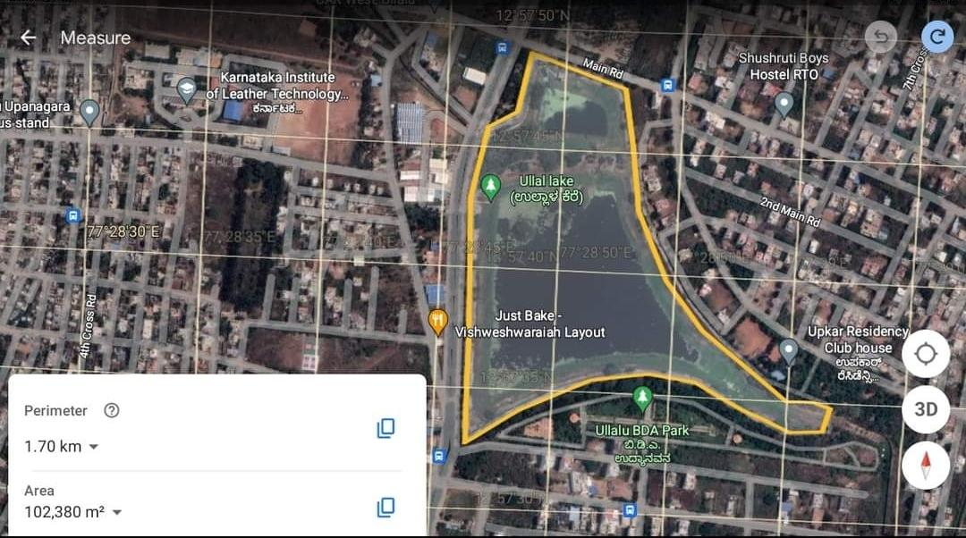
LAKE 2022: Conservation of wetlands: ecosystem-based
adaptation of climate change, December 28-30, 2022

Slide 6
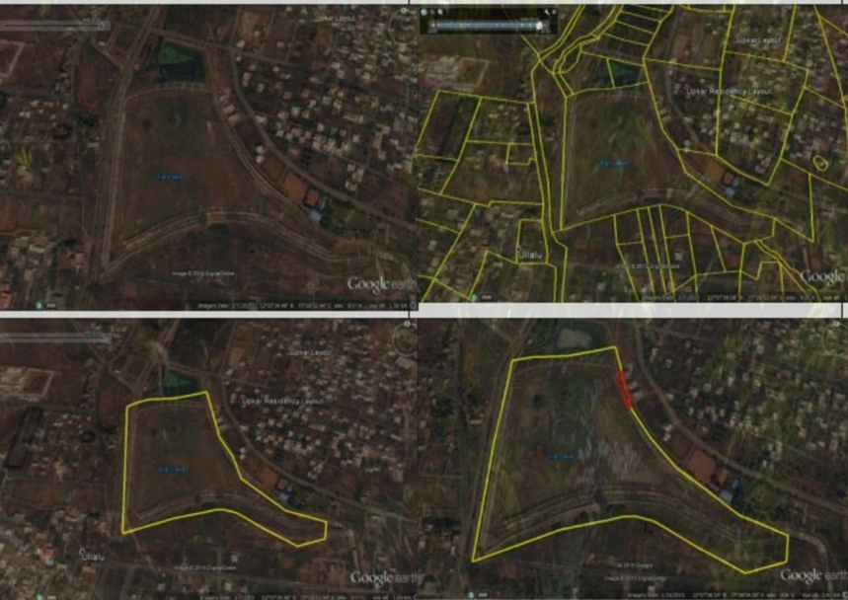
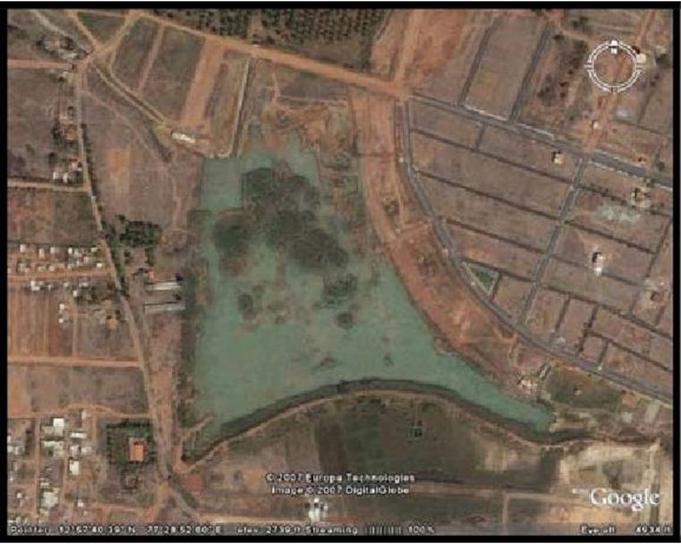
Comparative study
Year : 2008
Perimeter: 1870m
Area : 11.03ha
Year : 2016
Area : 9.833ha

Slide 7
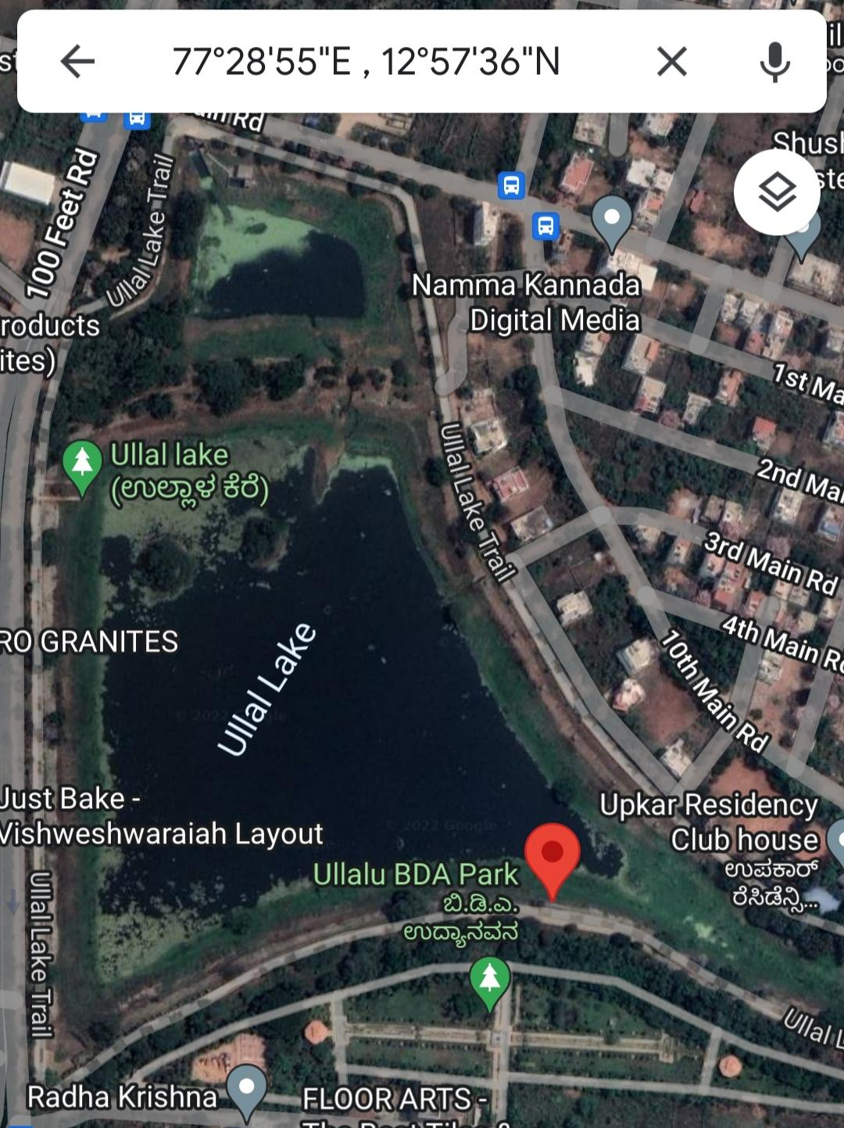
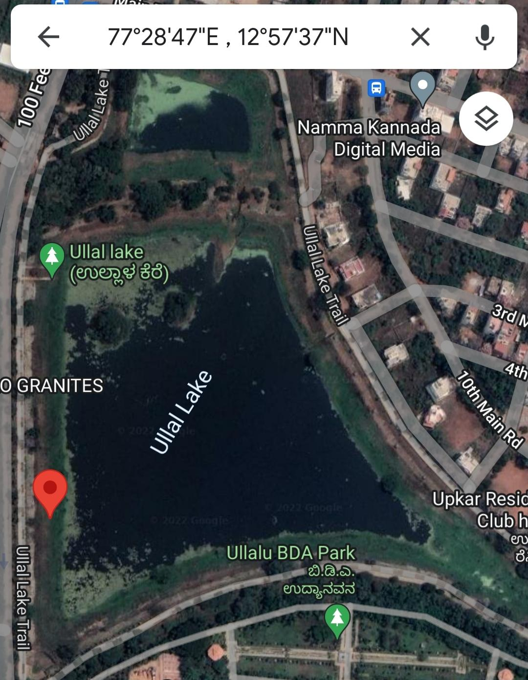
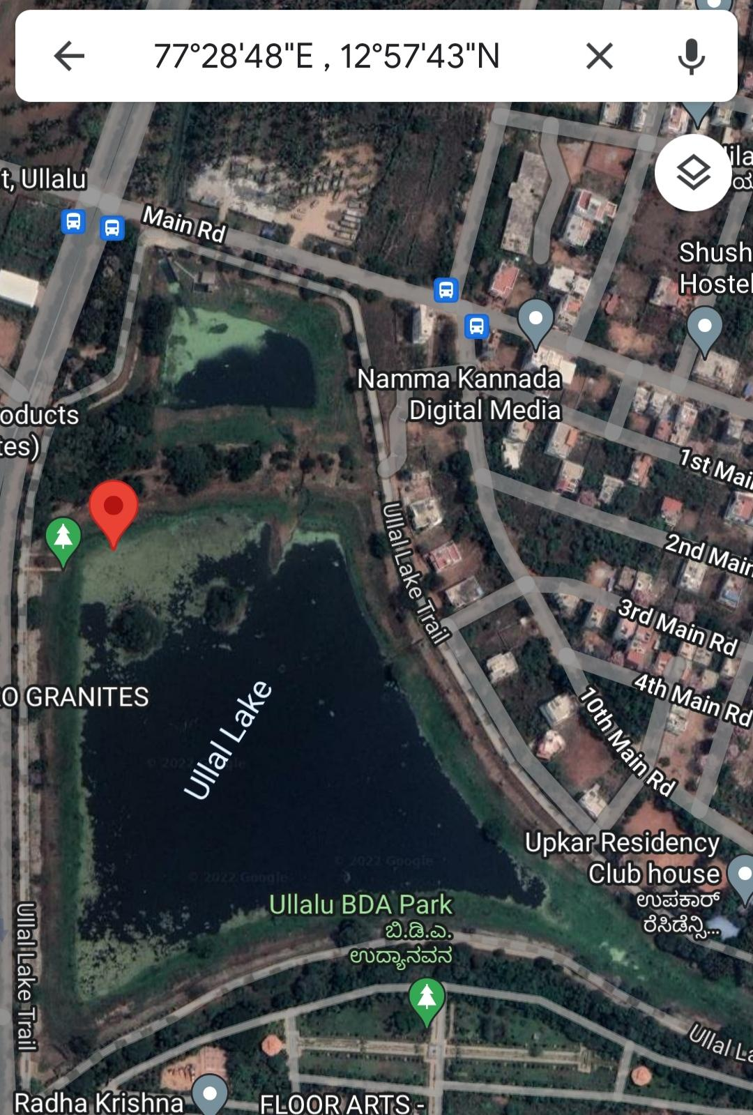
Sample Site 1
Sample Site 2
Sample site 3

Slide 8
Materials and Methods
Materials:
Total hardness testing kit
Alkalinity testing kit
Dissolved oxygen testing kit
pH paper and Universal indicator

Slide 9
Materials and Methods
Methods:
Collection of water from 3 different sample sites.
Testing of pH values and physical parameters.
Testing of biological parameters using compound microscopes and identification of microbes.
Testing of chemical parameters.

Slide 10
Results and Discussion - Physical parameters
Physical Parameters | Site 1 | Site 2 | Site 3
Colour | Clear water | Pale yellow | light brown
Temperature | 24 °C | 23 °C | 25 °C
Transparency | transparent | transparent | translucent

Slide 11
Chemical parameters
Chemical Parameters | Site 1 | Site 2 | Site 3
P^{H} | 7 - neutral | 9 - basic | 9 - basic
Hardness | 200 ppm | 150 ppm | 150 ppm
Alkalinity | 280 ppm | 750 ppm | 225 ppm
Dissolved oxygen | 10 mg/l | 4 mg/l | 2 mg/l

Slide 12
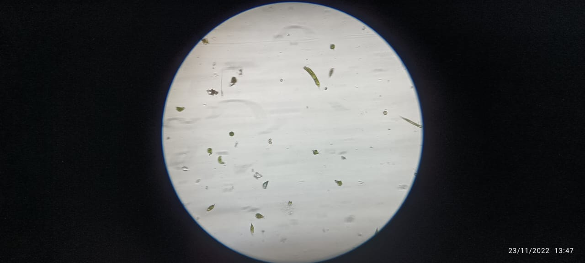
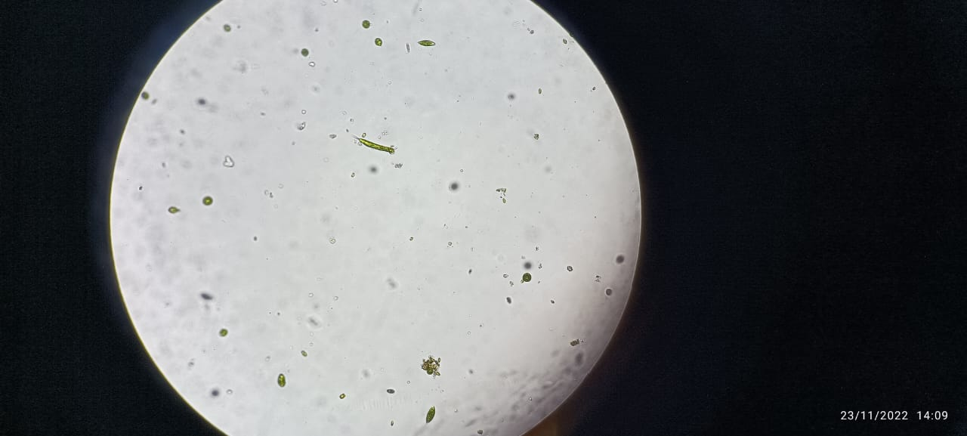
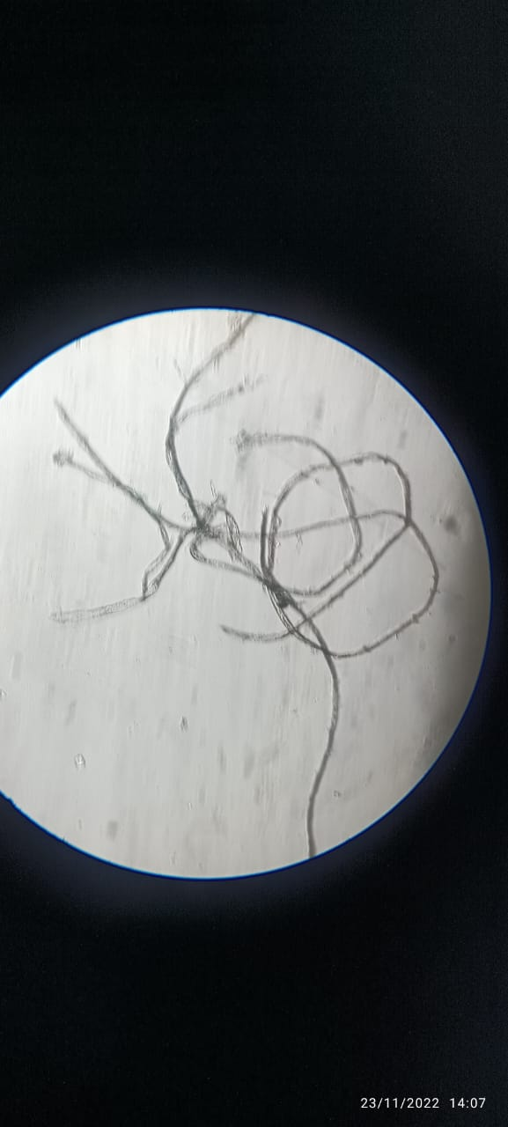
Biological parameters (Micro organisms found):
Diatoms
Chlorococcus and Plytomonas
Spirogyra

Slide 13
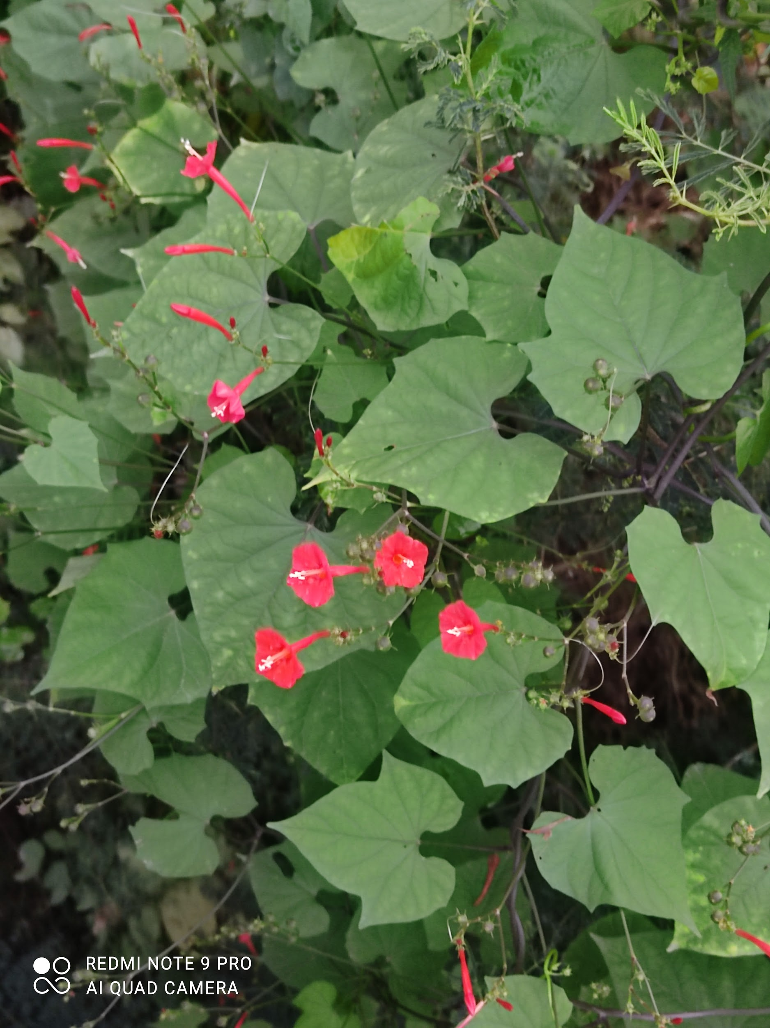
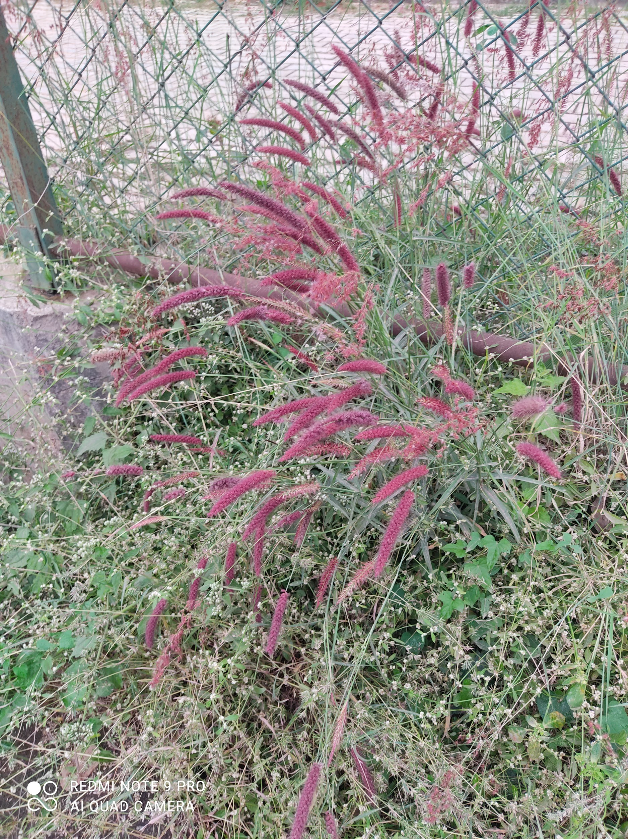
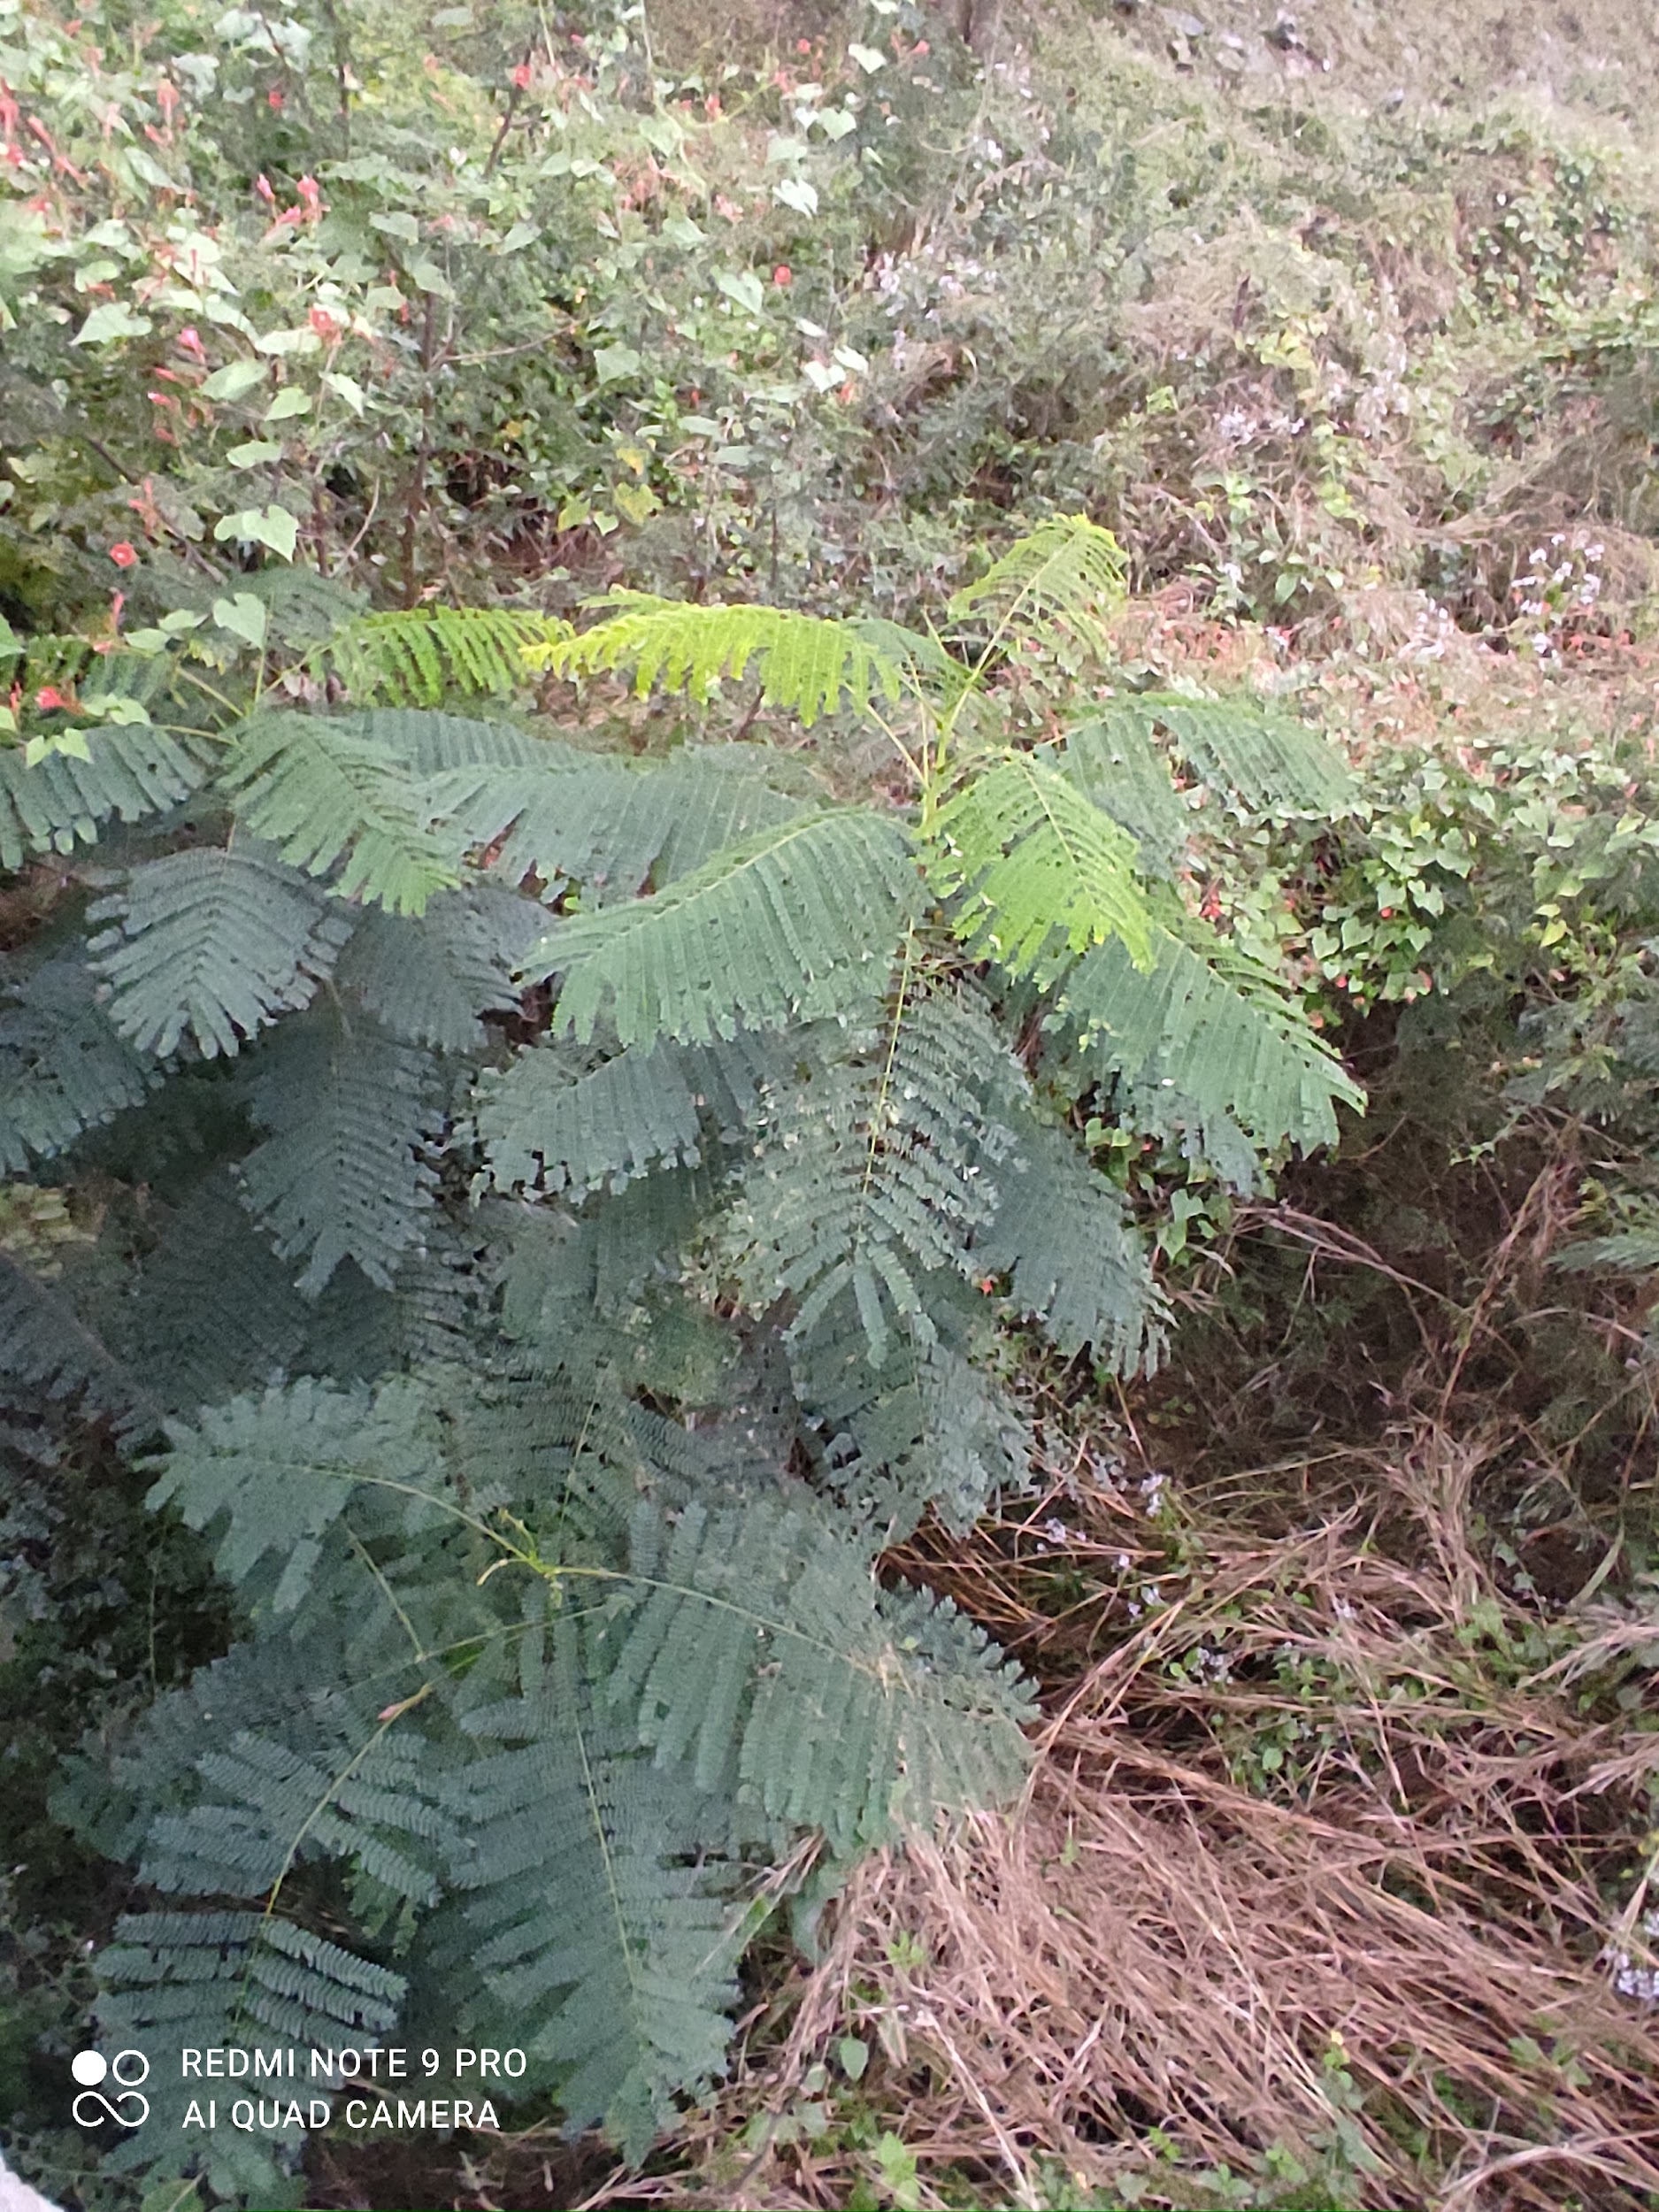
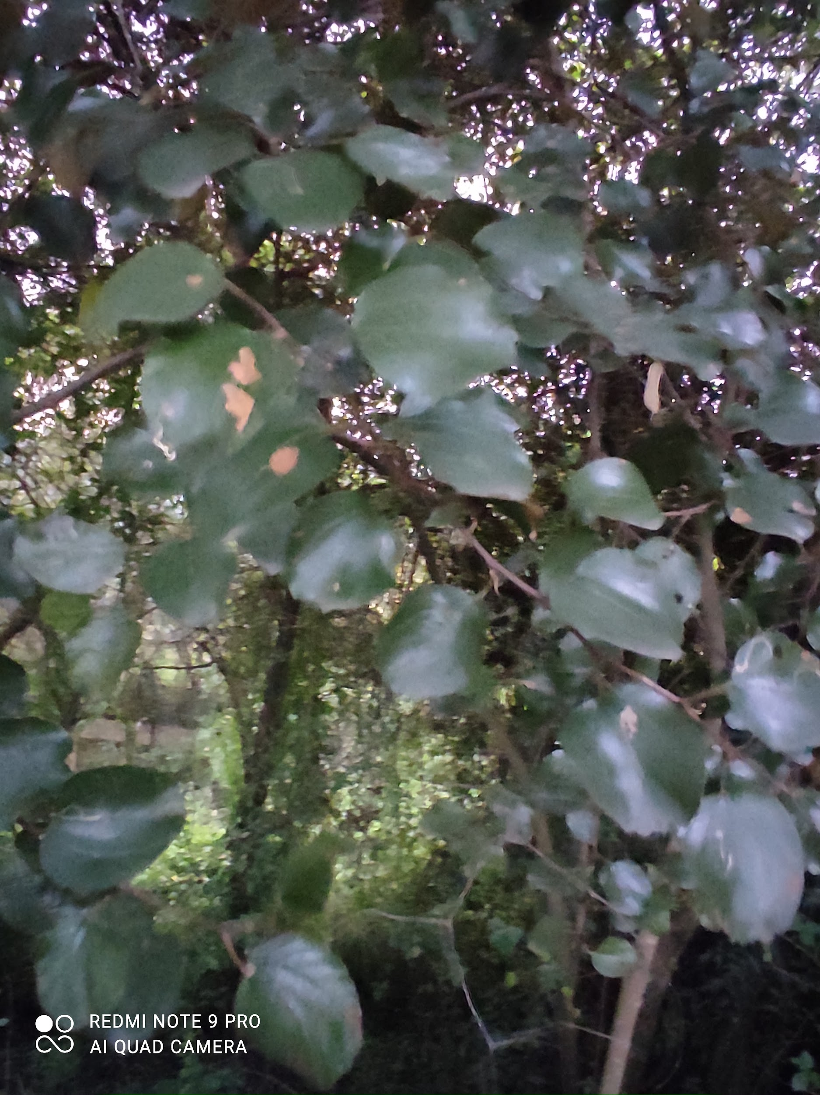
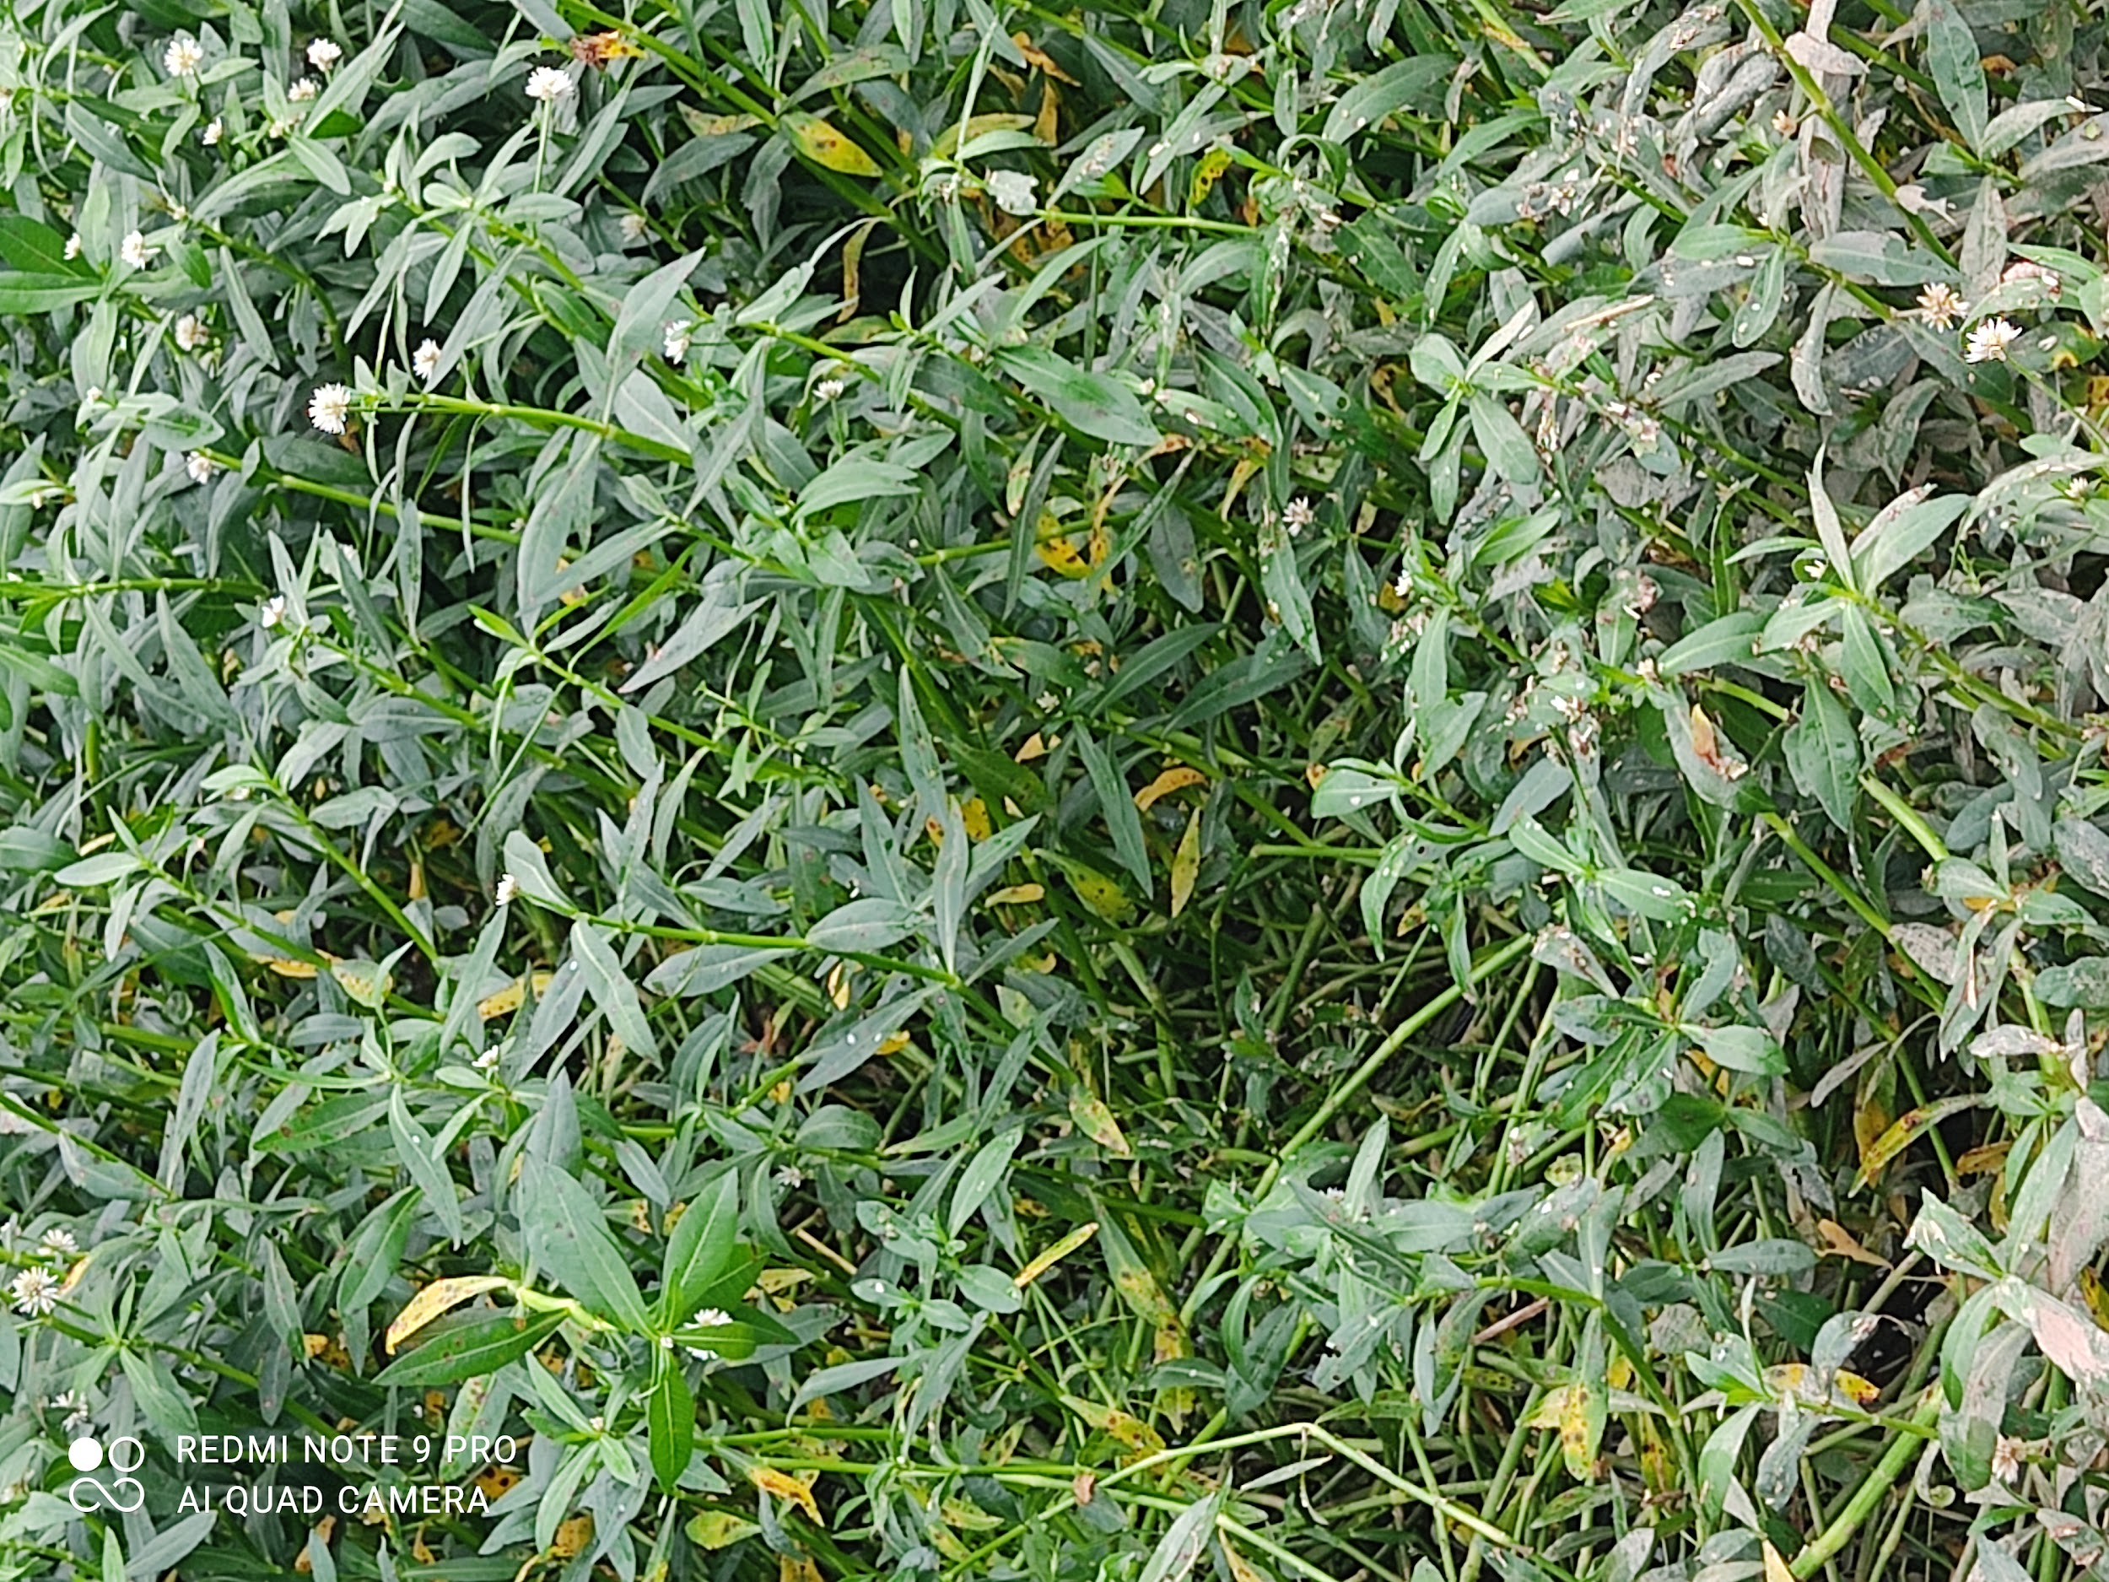
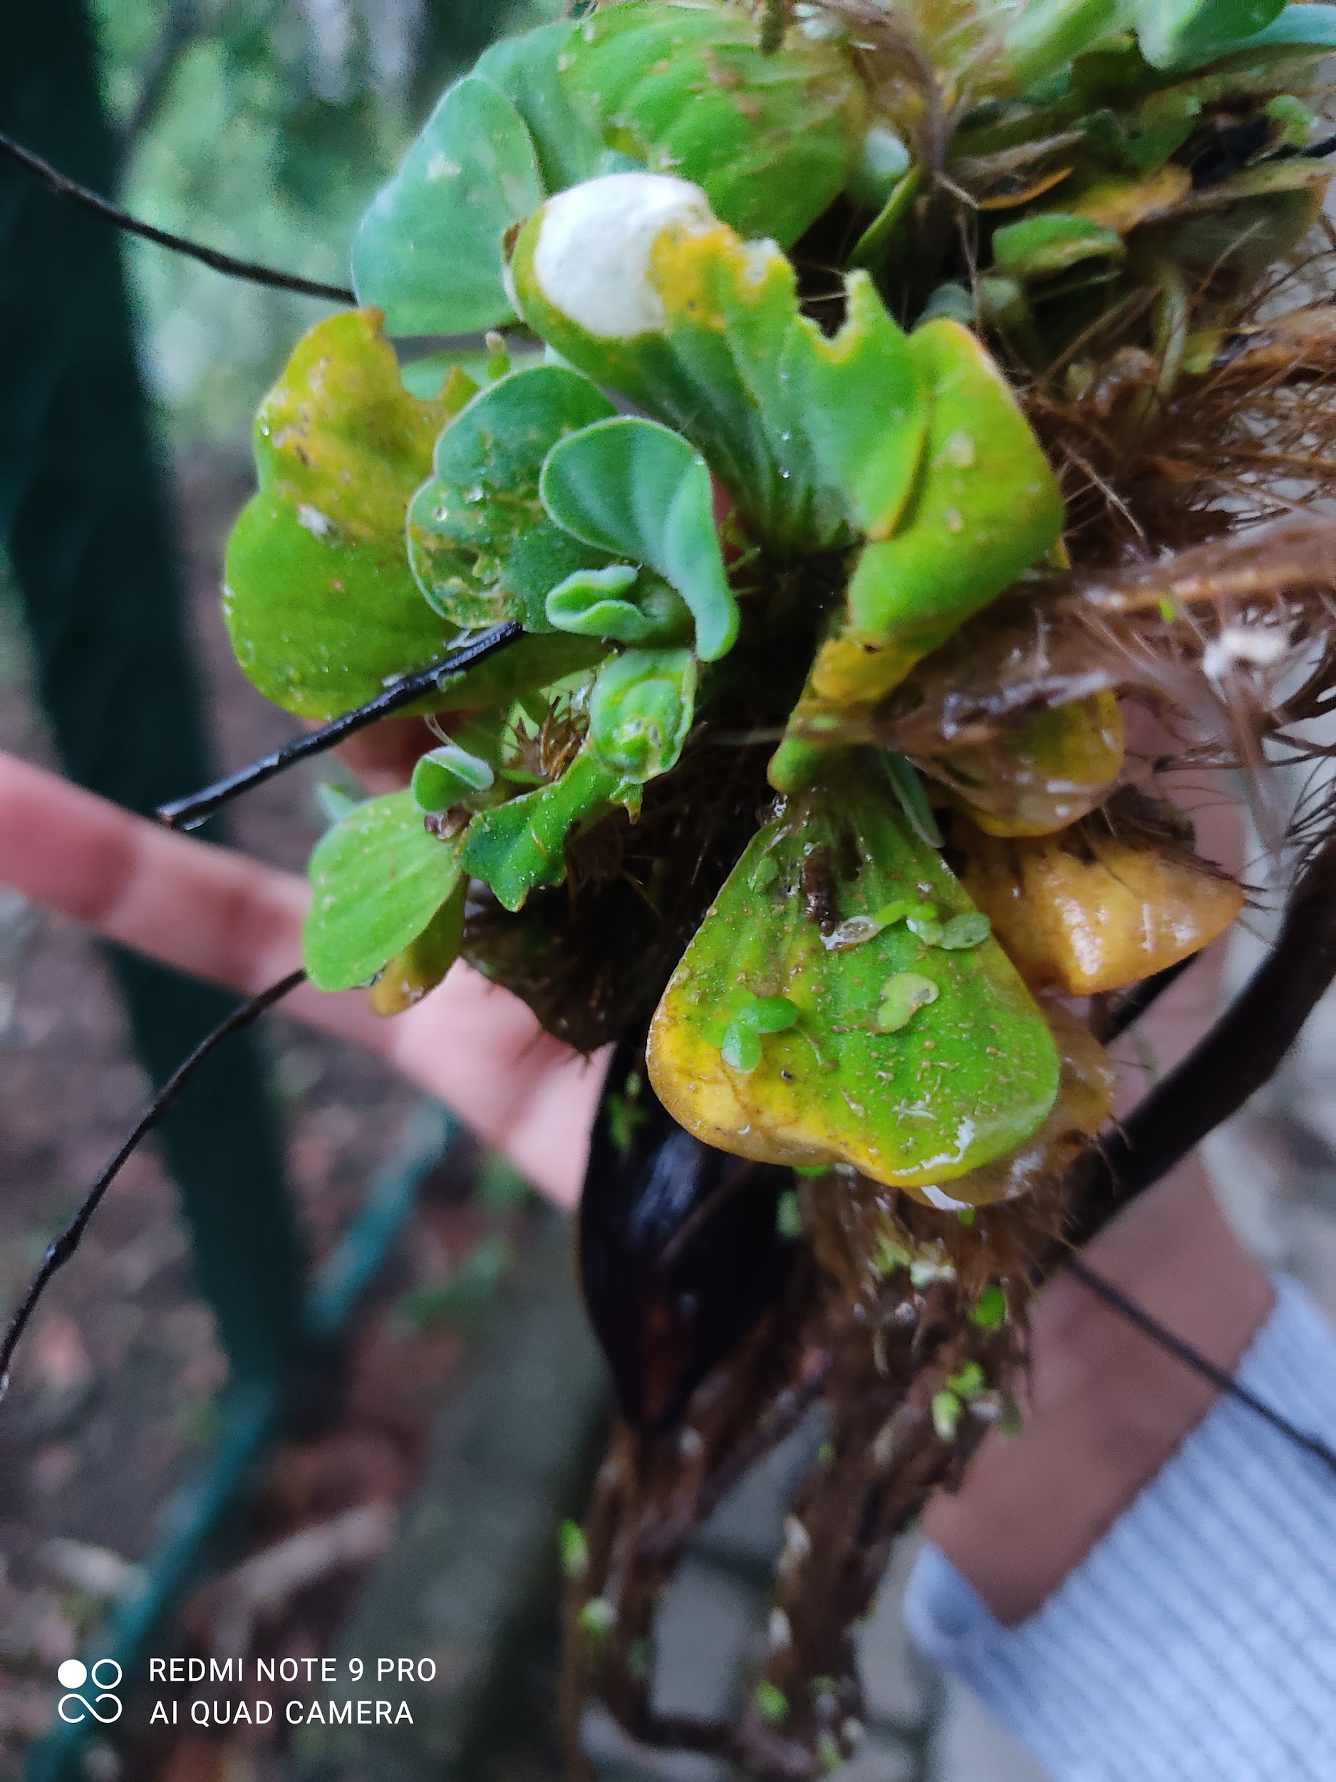
BIO DIVERSITY
Ipomea hederifolia
Albizia odoratissima
Fountain grass - pennisetum setaceum
Alligator weed - Alternanthera sessilis
Water lettuce - pistia

Slide 14
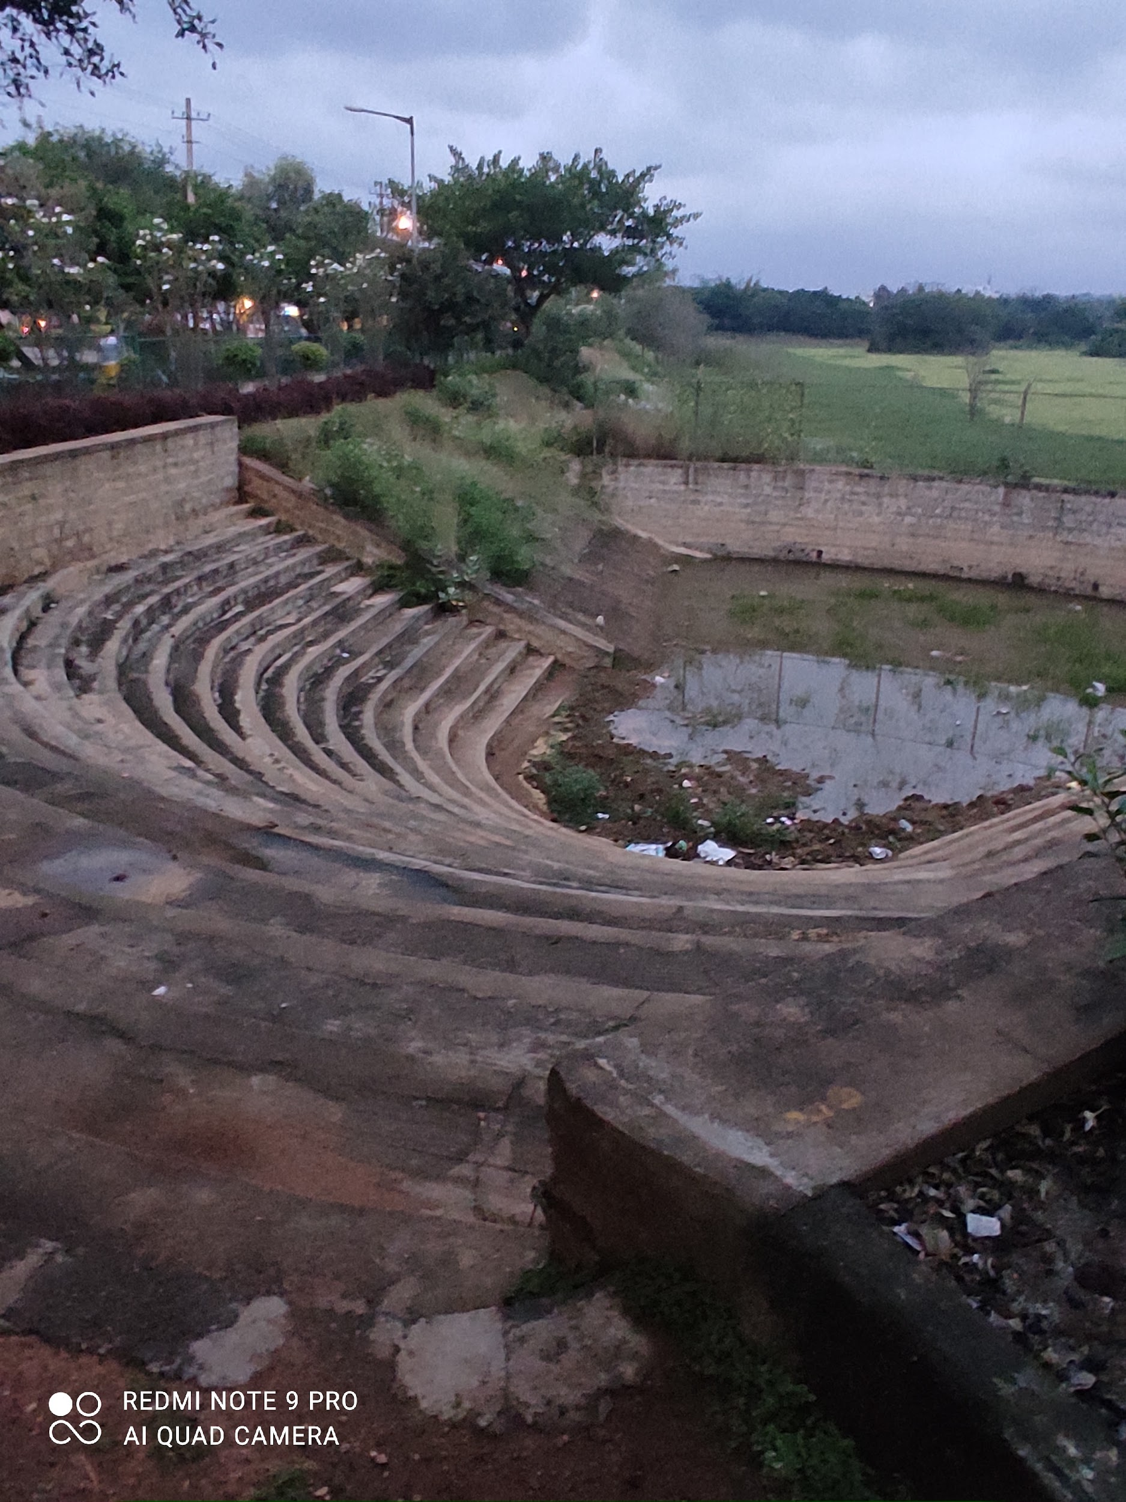
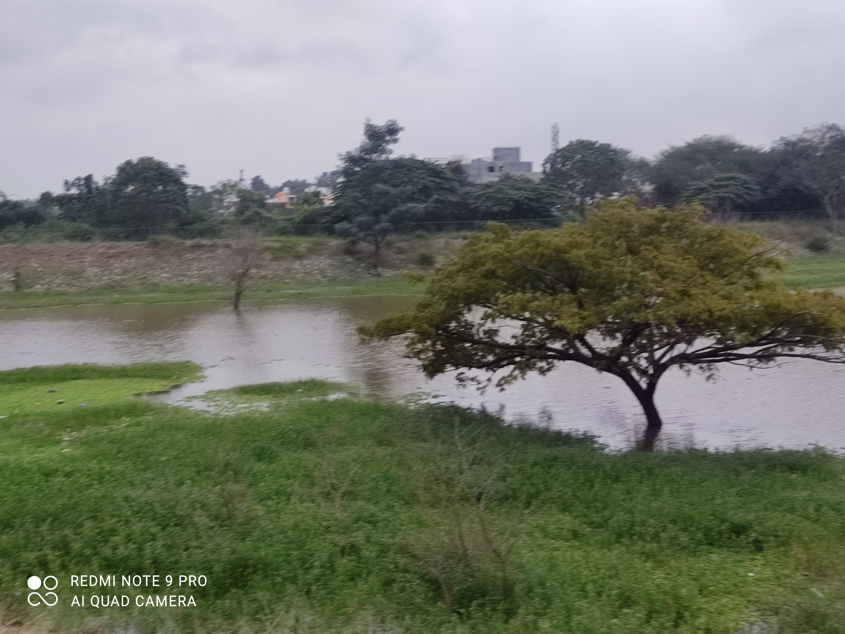
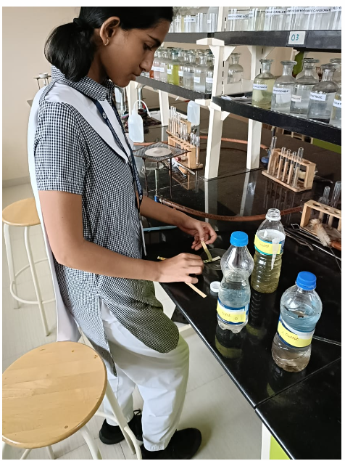
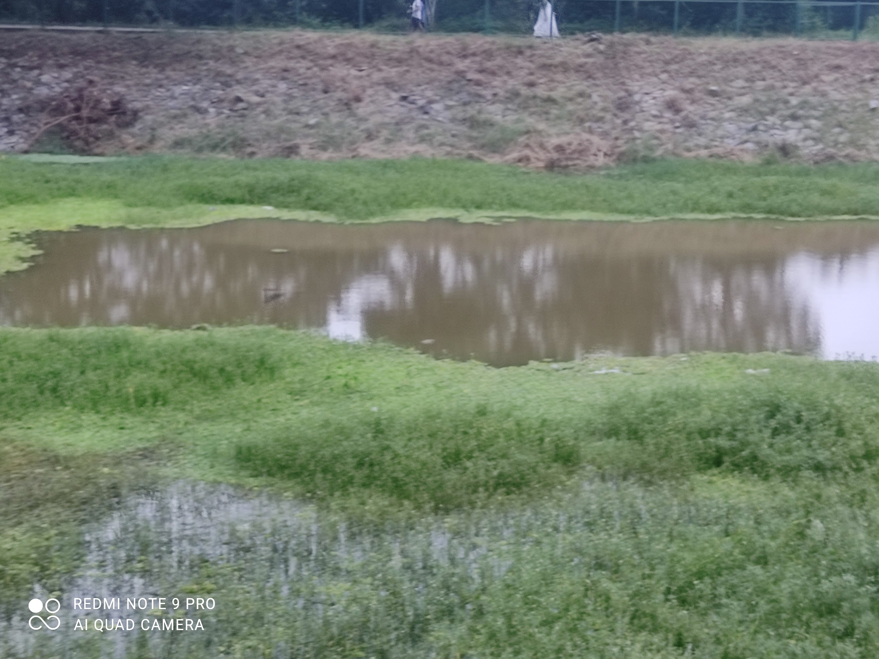
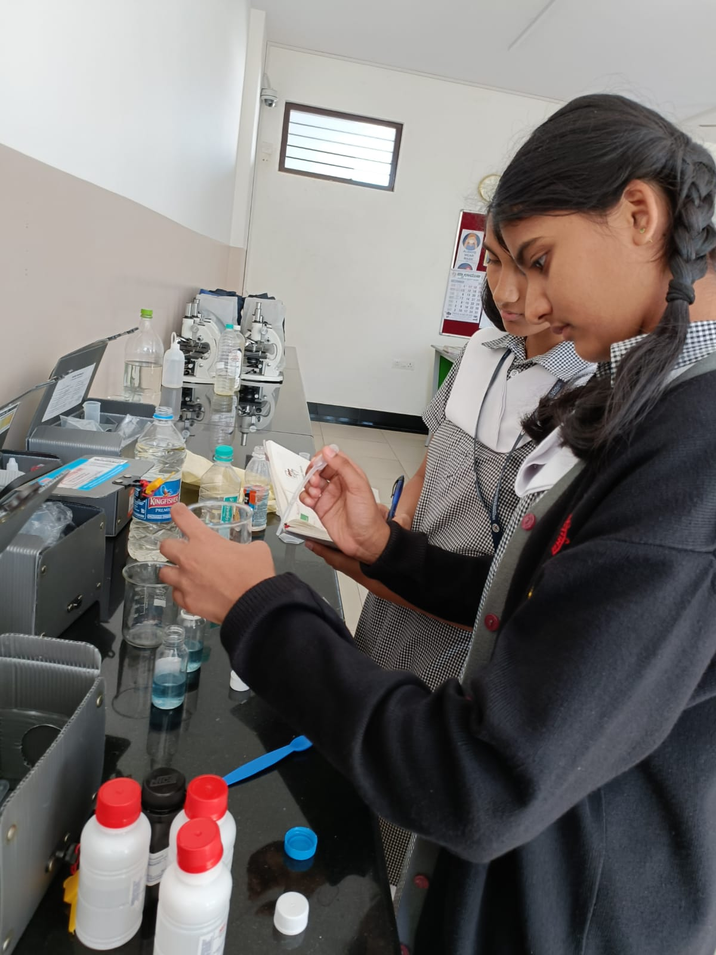
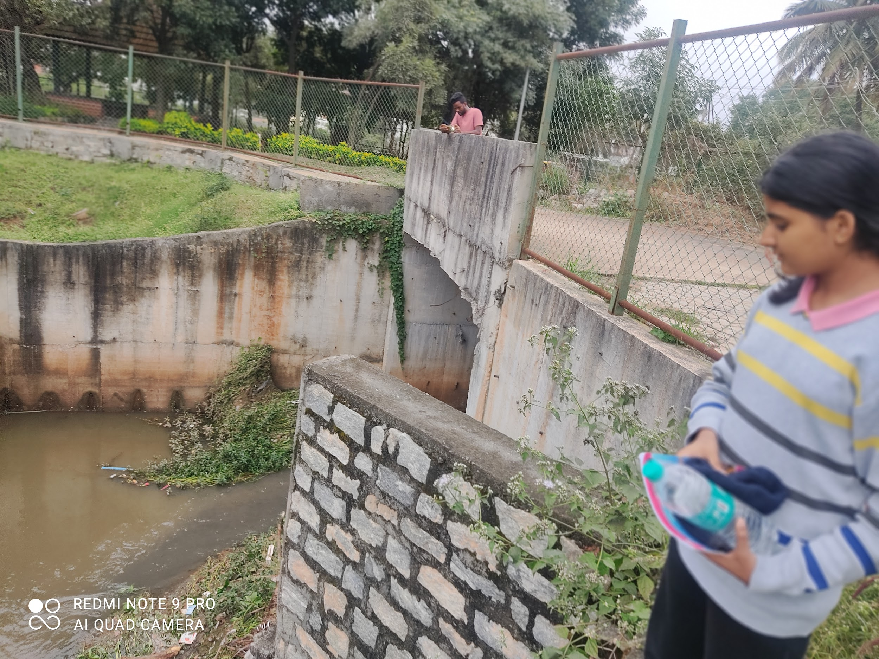
PICTURE GALLERY

Slide 15
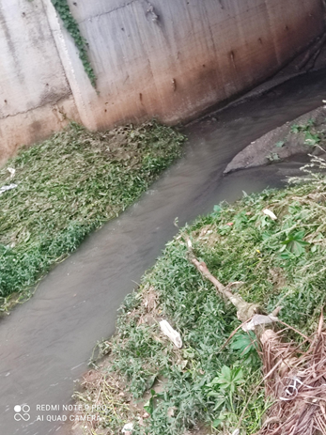
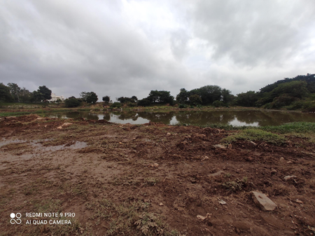
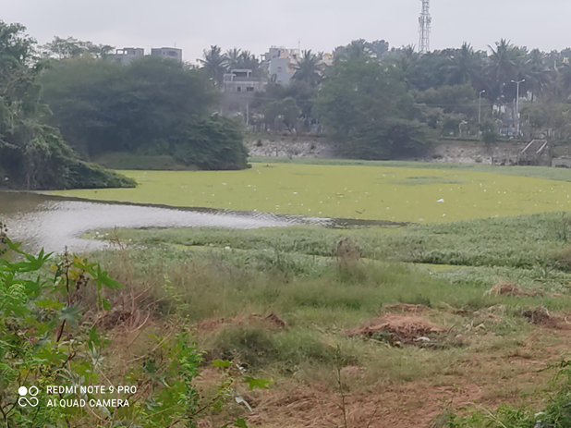
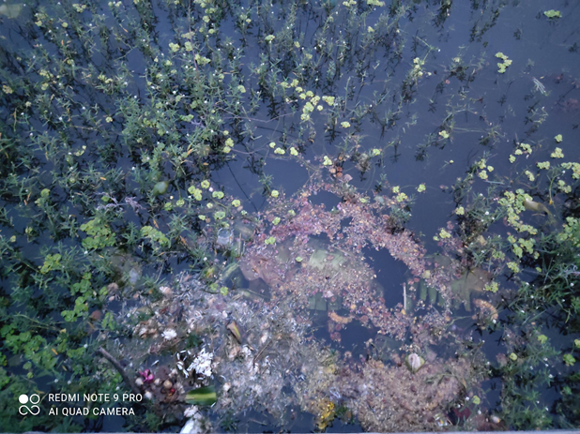
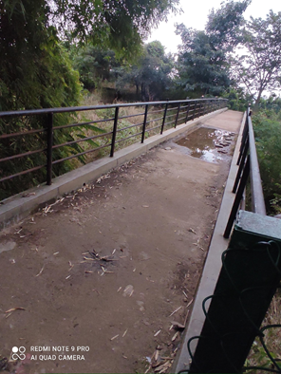

Slide 16
Issues
Water spread area of Ullal Lake is reducing despite rains.
Stormwater drains have been blocked by the development of new roads, and residential and commercial spaces around them.
Water is contaminated with sewage water and there is an unpleasant odour
The water is harmful for life forms due to the sewage waste present.

Slide 17
Conclusion and Recommendations
METHODS FOR WATER PURIFICATION
Activated carbon for treatment to remove color and odour from water.
Implementation of Floating Treatment Wetlands.
Bioremediation can help reduce eutrophication.
Urge the local government (BBMP) to recognize the anthropogenic activities and take the required measures to conserve the lake.

Slide 18
References
https://earth.google.com/web/@12.96067345,77.48137649,835.13813798a,1357.92603914d,35y,323.99220635h,0t,0r
https://iisc.ac.in/
https://onlinelibrary.wiley.com/journal/14401770
https://www.iisd.org/story/floating-treatment-wetlands/

Slide 19
Acknowledgement
We are really privileged to be a part of Lake symposium 2022 – 2023.
Our sincere thanks to IISC team.
We also extend our sincere thanks to vidyaniketan public school and respected teachers for guiding us through out this project.

Slide 20
Thank You

